Slide 1

Introduction to Angular 2
Hyderabad, 18 June 2016

Slide 2

Blog: http://sravi-kiran.blogspot.com
Author: Sitepoint, DotNetCurry
Organizer of ngHyderabad
Microsoft MVP (ASP.NET/IIS), DZone MVB
Twitter: @sravi_kiran
Ravi Kiran
InnoMinds

Slide 3
Agenda
Why rewrite?
Angular 2 Core Concepts: Components, Change Detection, Dependency Injection, Zones
Demos using Angular 2 and TypeScript
Intro to angular-cli

Slide 4

Why complete rewrite?

Slide 5
JavaScript is more matured now
Browsers are more matured now
Performance improvements
Saying bye to some of old friends (scope, modules, DDO, controllers, jqLite)
And several other reasons…
Why complete rewrite?

Slide 6
Unidirectional tree based change detection
Unidirectional flow is a win for performance
Change detection works with:
Plain JS Objects
Immutable Objects
Observable objects
Angular 2 Core: Change Detection

Slide 7
Dependencies are not created, they are injected
Single syntax for DI
E.g. constructor(e: EventEmitter)
Angular 2 Core: Dependency Injection

Slide 8
Three types of directives
Components
Attribute Directives
Structural Directives
Angular 2 Core: Directives

Slide 9
Tells the framework when to start acting
No need to call explicitly
Angular 2 Core: Zones

Slide 10
Angular 2 site and docs

Slide 11
Demos

Slide 12
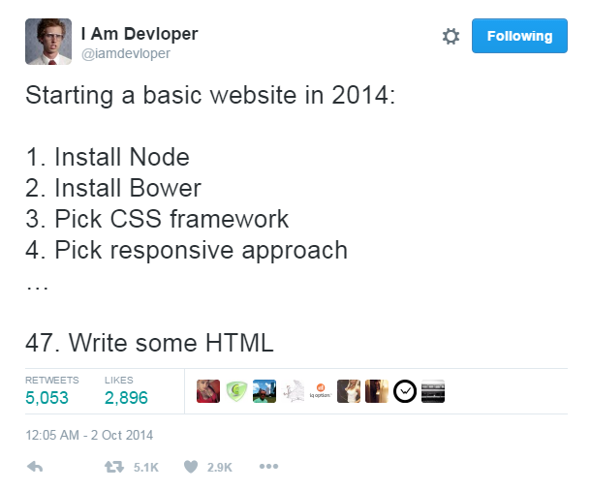
https://twitter.com/iamdevloper/status/517616294909464576

Slide 13
Angular 2 and its dependencies
Any other libraries and their typing files
TypeScript
Workflows to convert TypeScript to JavaScript
Production workflow
Web server to start application
Environment for Angular 2

Slide 14

http://www.angular.io
http://www.angularu.com
http://www.victorsavkin.com
http://www.ng-conf.org
Further Learning

Slide 15

Questions?

Slide 16
Thank-you

